Slide 1

Electricity Consumption Prediction
Students’ names:
Dania altman, lior alvas,
noam borger, Ben yaakobi,
Anzor Torikashvili, Georgiy Kravchenko
Supervisors’ names:
Mark Israel
Mayya lihovodov

Slide 2
Purpose of the research
Commercial electricity users in Ukraine are required to state how much electricity they are going to use in each following month and buy it accordingly. However, if they don't use all of it, they practically lose money. On the other hand, the fee for excessive usage is twice(and sometimes three times) than the regular fee by the law. According to recent statistics, AWDP increased to UAH 585 per MWh in 2015.
As a result, these users are seeking the most accurate estimation(or prediction) of the following month's usage.
Hence, this study's aim is to predict, with at least 95% accuracy, the electricity usage of commercial entities.
To achieve this kind of accuracy, this research will include Machine Learning algorithms that would take into account various factors that could affect the power consumption, such as: weather conditions, factory machines' power usage, etc.

Slide 3

Random Forest
Random forests is an ensemble learning method used for classification and regression that operates in the way of constructing a multitude of decision trees at training time. For classification tasks, the output of the random forest is the class selected by most trees. For regression tasks, the mean or average prediction of the individual trees is returned. Random decision forests correct for decision trees' habit of overfitting to their training set. Random forests generally outperform decision trees, but their accuracy is lower than gradient boosted trees. However, data characteristics can affect their performance.

Slide 4
DataStructure Description
A - Active power: The power which is actually consumed or utilized in an AC Circuit is called True power or Active power or Real power. It is measured in kilowatt (kW) or MW. It is the actual outcomes of the electrical system which runs the electric circuits or load.
Positive sign: The component shows inductive behavior. When the active power flows from the “source” through the metering point and into the “load” we say the Active Power (Watts) are being DELIVERED. Hence when the Active Power is being supplied by the “SOURCE” into the load it will be referred to as Delivered Power (Watts) and has a positive sign.
Minus: The component shows capacitive behavior. When the Active Power (Watts) flows from the “LOAD” through the metering point and into the “SOURCE” we say the Active Power (Watts) are being RECEIVED. Therefore when the Active Power is being supplied by the “LOAD” into the source it will be referred to as Received Power (Watts) and has a negative sign.
R - Reactive power: The power which flows back and forth that means it moves in both the directions in the circuit or reacts upon itself, is called Reactive Power. The reactive power is measured in kilo volt-ampere reactive (kVAR) or MVAR.
Positive sign: The component shows capacitive behavior. When the Reactive Power (Vars) flow from the “SOURCE” through the metering point and into the “LOAD” we say the Reactive Power (Vars) are being DELIVERED. Therefore when the Reactive Power is being supplied by the “SOURCE” into the load it will be referred to as Delivered Reactive Power (Vars) and have a positive sign.
Negative sign: The component shows inductive behavior. When the Reactive Power (Vars) flow from the “LOAD” through the metering point and into the “SOURCE” we say the Reactive Power (Vars) are being RECEIVED. Therefore when the Reactive Power is being supplied by the “LOAD” into the source it will be referred to as Received Reactive Power (Vars) and have a negative sign.
dts: The dates can affect the power consumption through weather and holidays.
real_val: The purpose variable shows the amount of electricity consumed.
weather parameters: As a part of the prediction there is a need to use some factors to predict the power usage. We use temperature, humidity, wind direction, cloud type - because these factors affect the power consumption as the studies have shown.

Slide 5
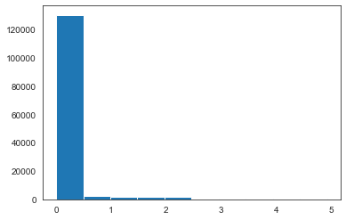
EDA
As can be seen from the diagram, most of the values of "real val" are between 1 and 0 and rather close to 0. This means that they are very small values.
When we examined and compared the different graphs of each year, we realized that there is no difference between them. Moreover, we not only compared the years, but also looked to see if there was a difference between the generators, and they were similar as well. Therefore, we did not treat any of them differently.

Slide 6
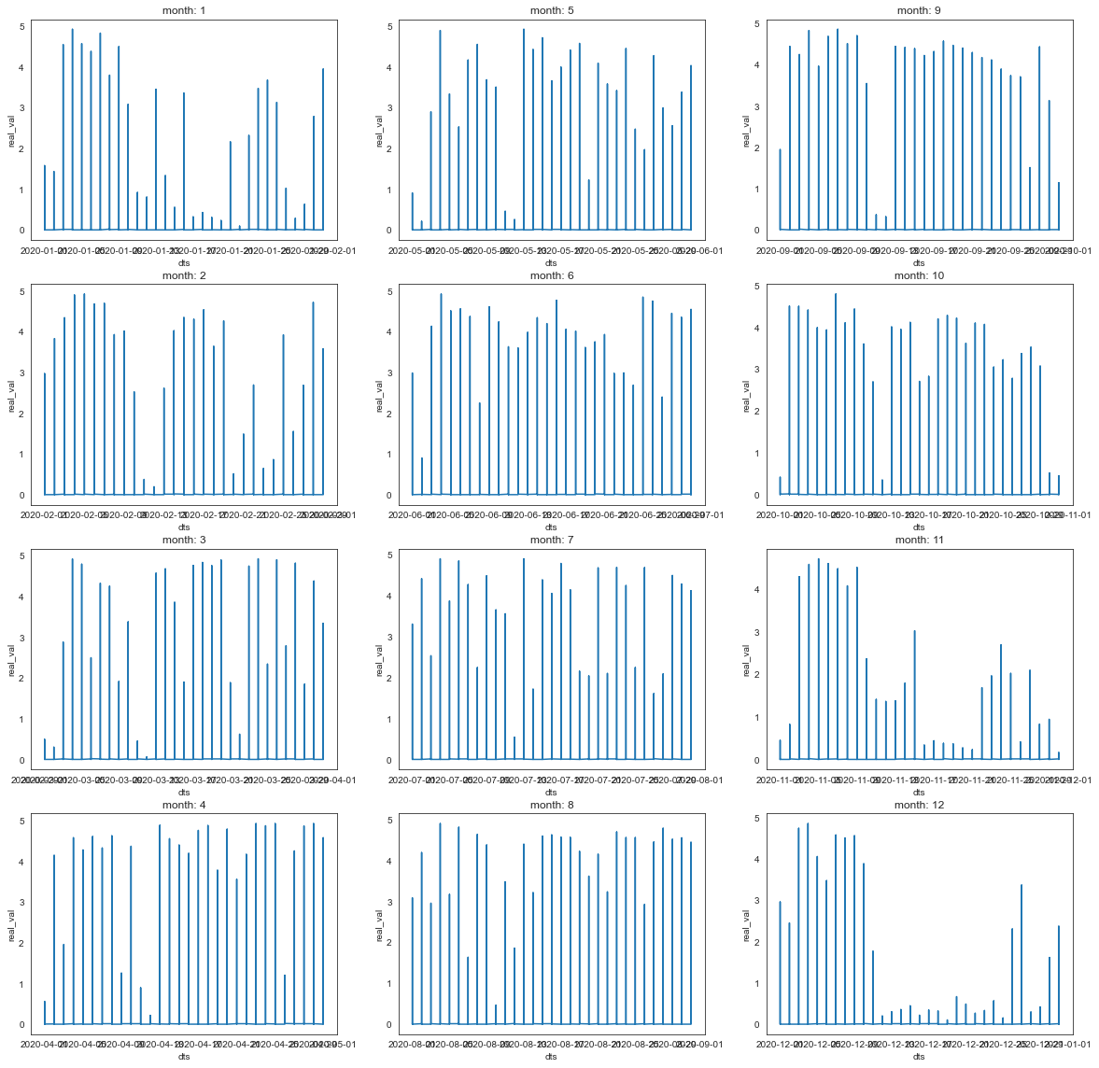
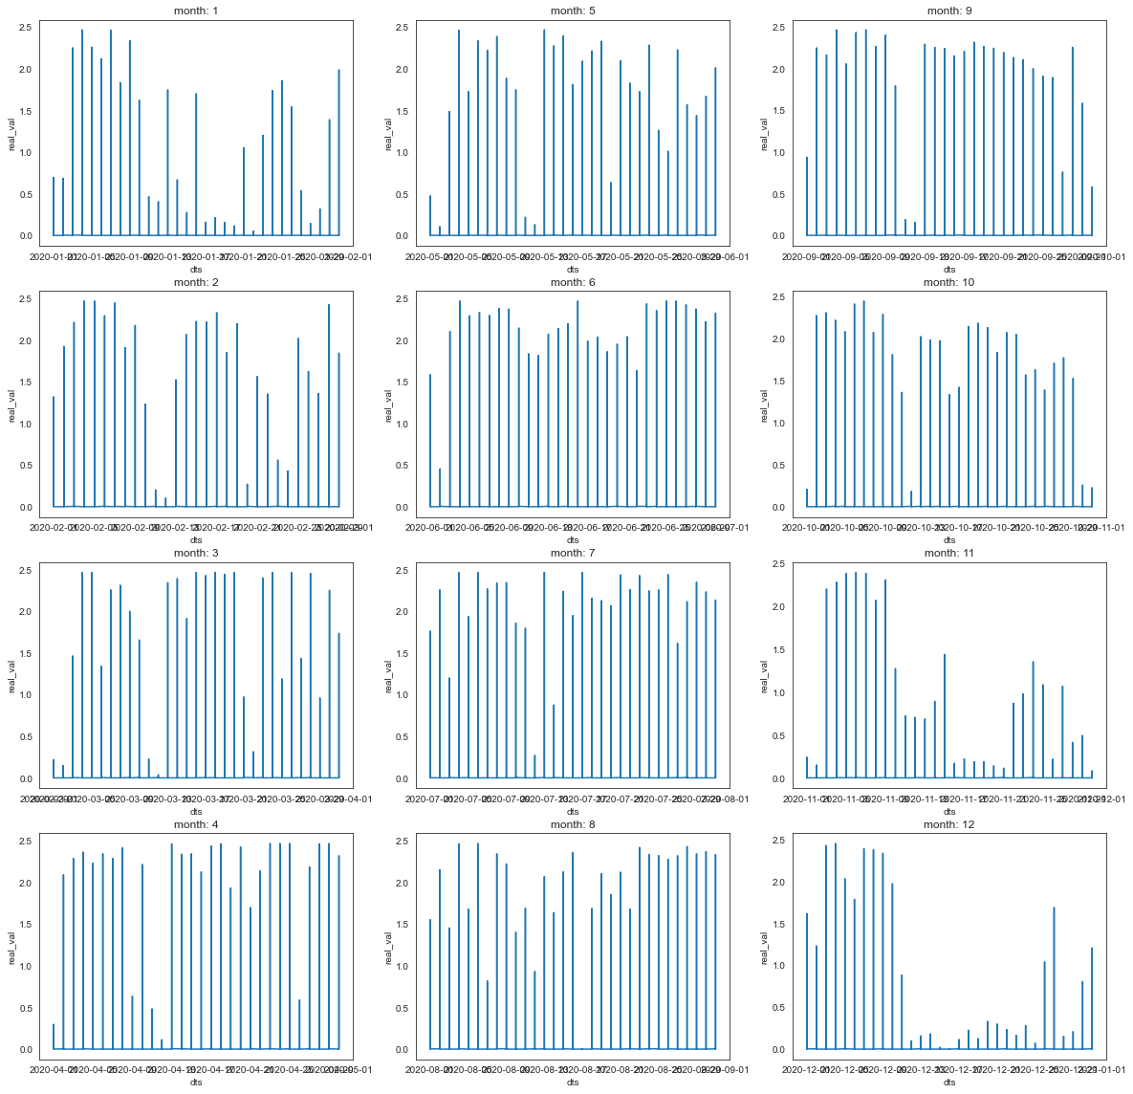
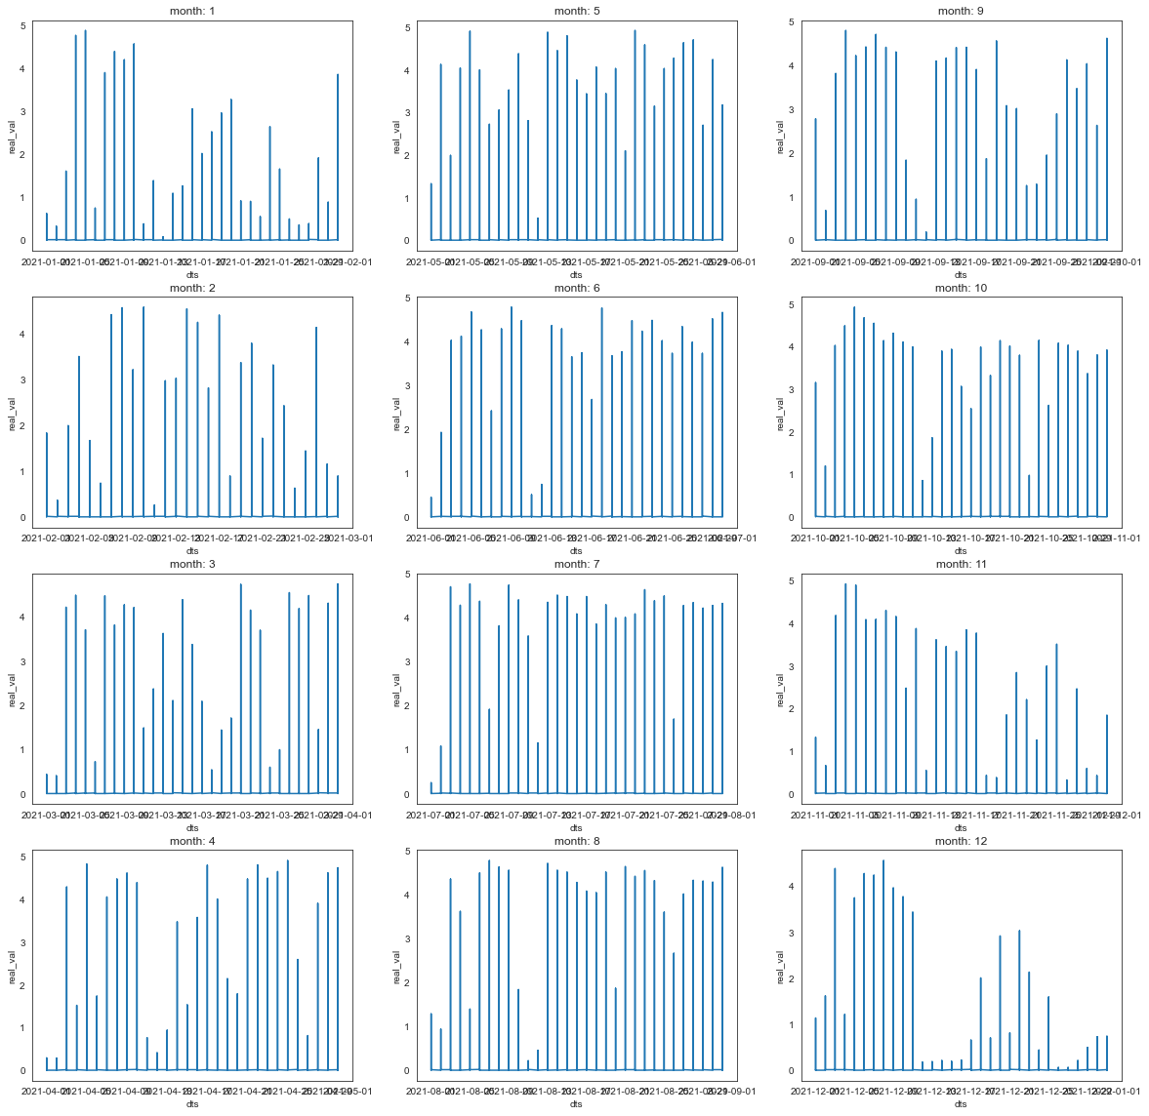
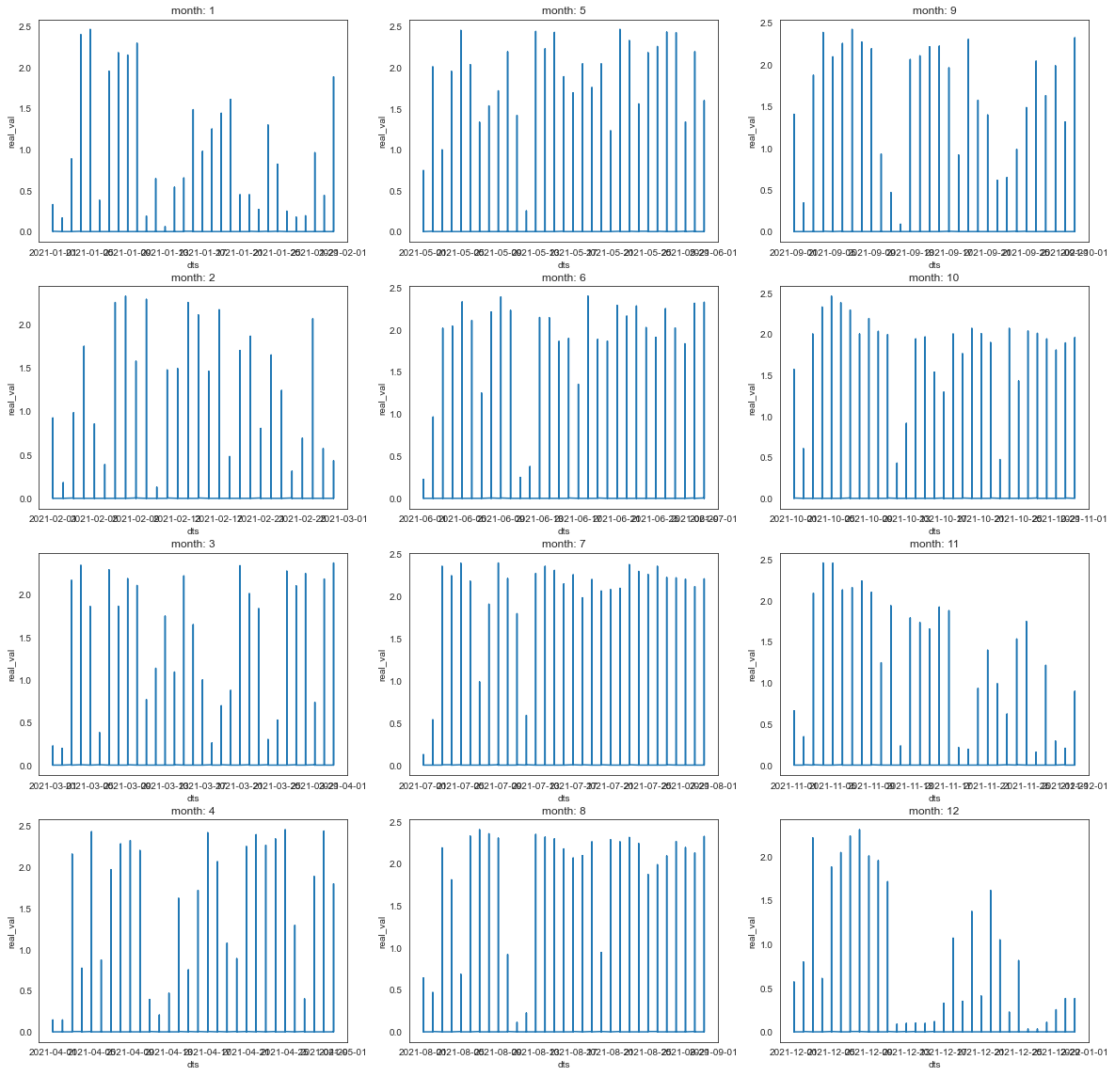
According to the diagrams, comparing the different years and the different generators in terms of months, we realized that there is a correlation between the time of the month and the energy consumption. At the end of each month, the consumption is higher than at the beginning of the month. Therefore, it is necessary to take this into account in the process.
Year: 2020 ,generator: 1
Year: 2020 ,generator: 3
Year: 2021 ,generator: 1
Year: 2021 ,generator: 3

Slide 7
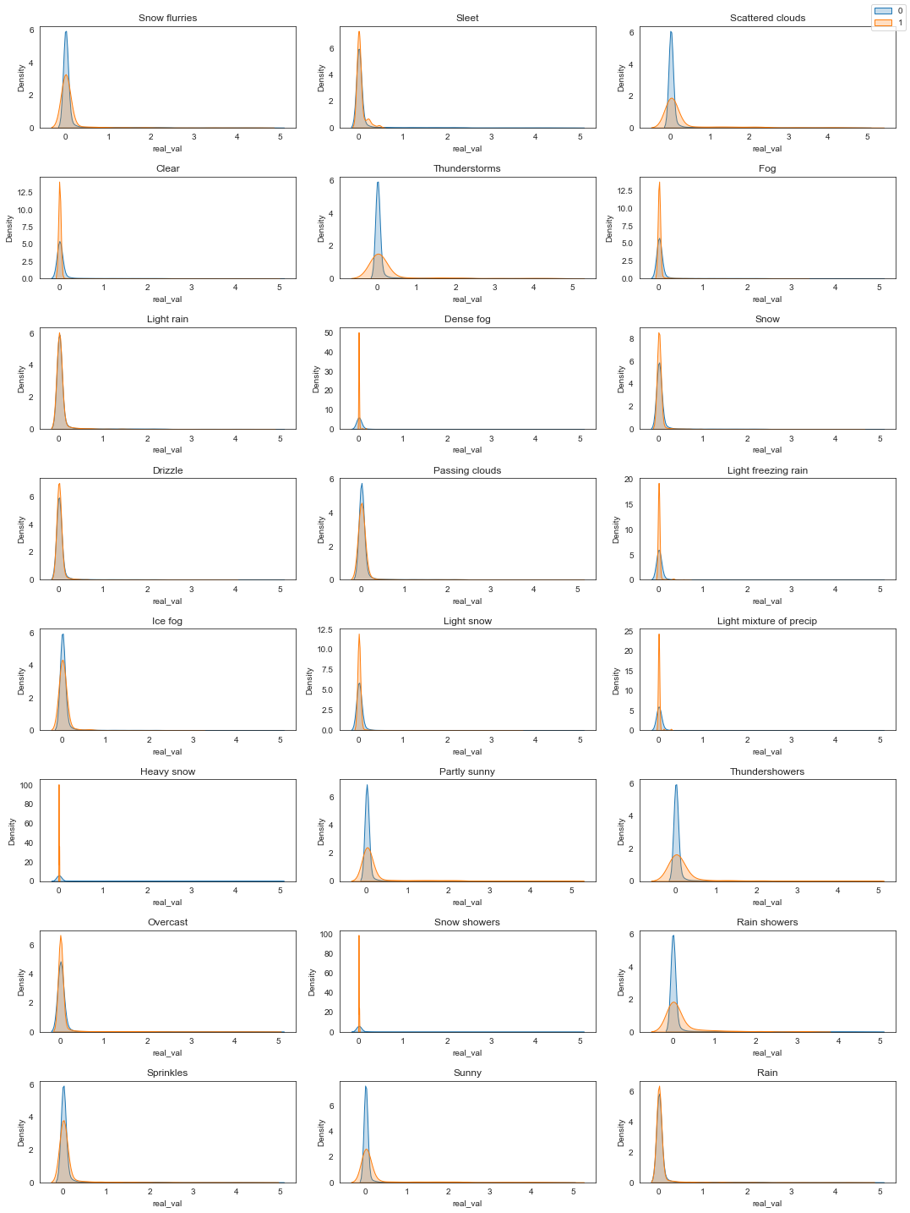
We know from the diagram of the "Density-Weather Parameters" that if the density is similar, we can assume that the variable does not contribute much. Therefore, we only used the different variables.

Slide 8
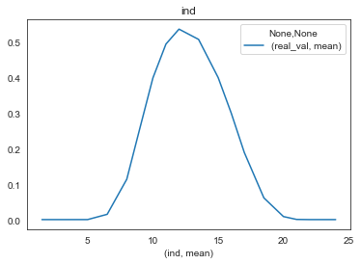
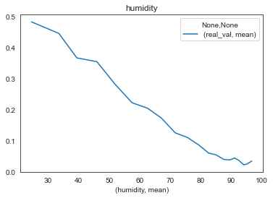
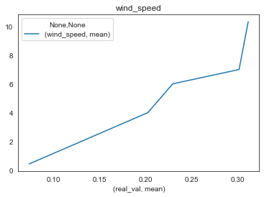
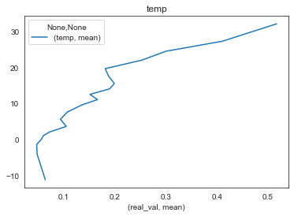
Pivot diagrams allow us to see what features we need to use to predict power consumption as accurately as possible. As shown in diagrams, wind speed, humidity, time of day, and temperature affect electricity consumption, and we need to use them to predict electricity consumption.

Slide 9
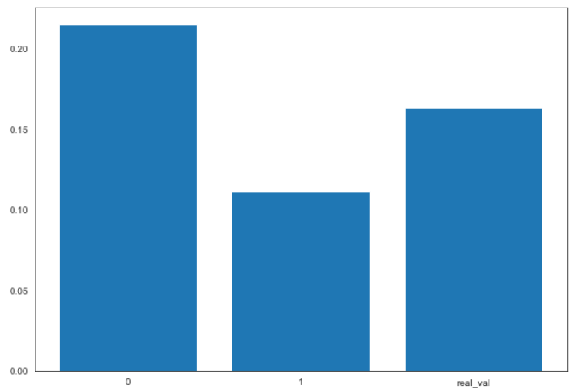
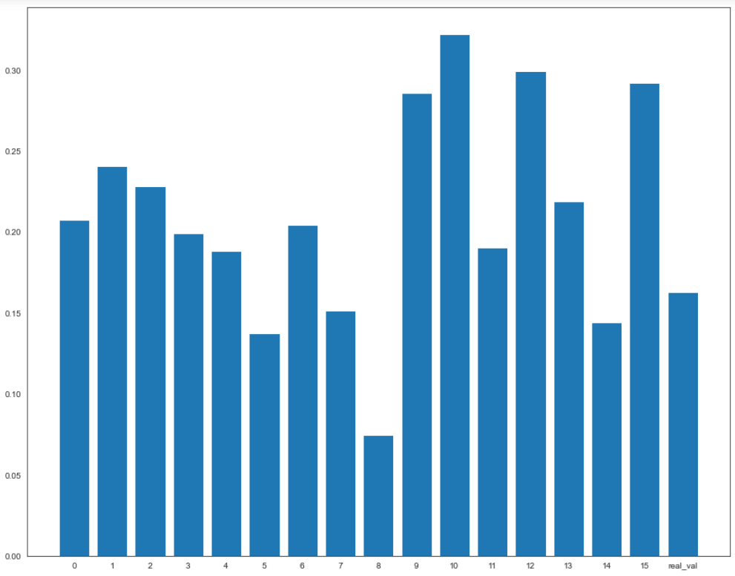
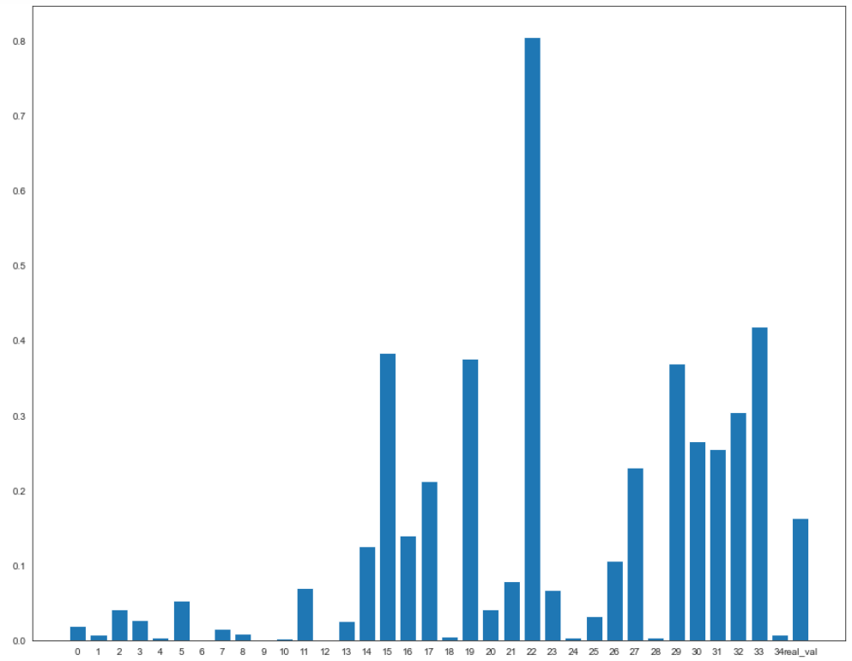
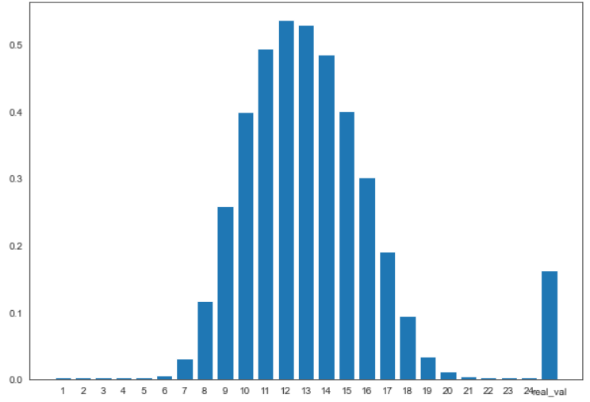
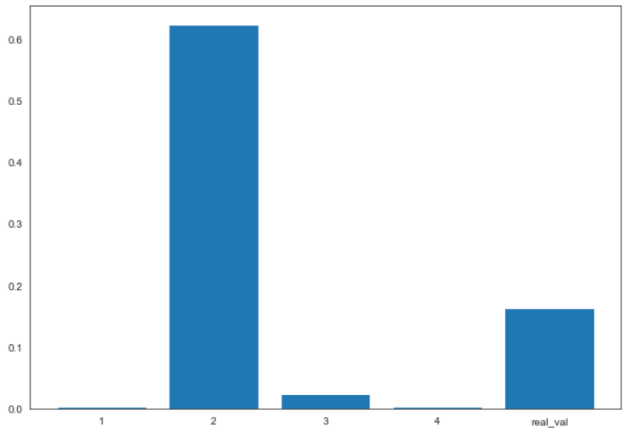
In the graphs we examine each feature and in that feature we searched the values that were the same in order to replace the similar one due to the fact that we don't want that in one feature to have similar values for the different column, for example: time that can have a big influence on the final result.
Bar plot for each of the fiders and their average power consumption
Bar plot real val and wind direction
Box plot of each weather category and its average power consumption
bar plot ‘ind’ (hour in the day) and average ‘real_ val’
Box plot of the direction and its average power consumption

Slide 10
Feature Selection
Finally, after examining each feature and making changes that were made in order to fit the features to the model in the best way, the correlation of each feature with the features with 'real val' (electricity consumption) was determined. The result showed that the features that had the highest correlation were: 'idfiders', 'ind', 'dr', 'weather_categories', 'wind_dir', 'wind_speed', 'temp'.
Thus, the use of this feature in the model was directly related to the success of the power consumption prediction model.
Moreover, the future 'humidity' has a high correlation with electricity consumption - 'real val', but it also has a correlation above the value of 0.4 with temperature - 'temp', as a result of that fact we can omit it.

Slide 11
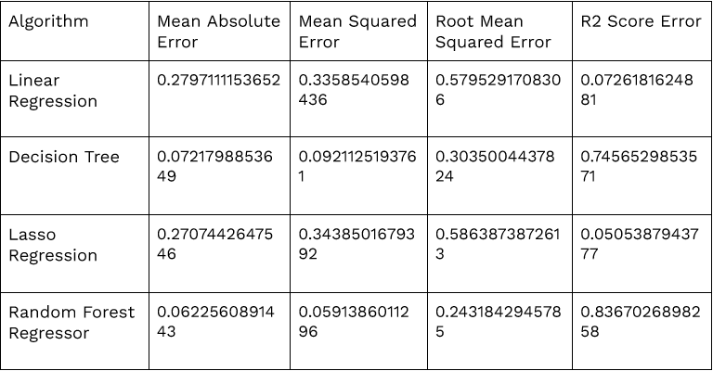
Algorithm Selection
As seen in the table, Random Forest Regressor algorithm yields the best results and therefore we went with this choice.
Moreover, we used cross validation with kFold=10 to make sure the results are true. As seen in the table on 5.3 the results of r2 score are close to each other therefore the model that we chose was accurate.

